Slide 1

CSC 533: Privacy in the Digital Age (Fall 2020) Lecture 12: Tor Networks
Anupam Das
Sept. 22, 2020

Slide 2
Goals for today
How Tor works?
Properties of Tor
Attacks on Tor
Some slide contents taken from Roger Dingledine, Vitaly Shmatikov, George Danezis, Christo Wilson

Slide 3
Basic Mix Design
B
{r₁,{r₀,M}_{pk(B)},B}_{pk(mix)}
{r₀,M}_{pk(B)},B
A
{r₅,M’’}_{pk(B)},B
C
E
{r₂,{r₃,M’}_{pk(E)},E}_{pk(mix)}
{r₃,M’}_{pk(E)},E
D
Mix
{r₄,{r₅,M’’}_{pk(B)},B}_{pk(mix)}
Adversary knows all senders and
all receivers, but cannot link a sent
message with a received message

Slide 4
Mix Cascade
Messages are sent through a sequence of mixes
Can also form an arbitrary network of mixes (“mixnet”)
Some of the mixes may be controlled by attacker, but even a single good mix guarantees anonymity
Pad and buffer traffic to foil correlation attacks

Slide 5
Onion Routing
[Reed, Syverson, Goldschlag 1997]
R
R
R₄
R
R₃
R
R₁
R
R₂
Alice
R
Bob
Sender chooses a sequence of routers
Some may be honest, some controlled by attacker
Sender controls the length of the path

Slide 6
Route Establishment
R₂
R₄
Alice
R₃
Bob
R₁
{M}_{pk(B)}
{B,k₄}_{pk(R4)},{ }_{k4}
{R₄,k₃}_{pk(R3)},{ }_{k3}
{R₃,k₂}_{pk(R2)},{ }_{k2}
{R₂,k₁}_{pk(R1)},{ }_{k1}
K_{i} are keys to be used to respond
Routing info for each link encrypted with router’s public key
Each router learns only the identity of the next router

Slide 7
Disadvantages of Basic Mixnets
Public-key encryption and decryption at each mix are computationally expensive
Basic mixnets have high latency
Ok for email, not Ok for anonymous Web browsing
Challenge: low-latency anonymity network
Use public-key cryptography to establish a “circuit” with pairwise symmetric keys between hops on the circuit
Then use symmetric decryption and re-encryption to move data messages along the established circuits
Tor: 2nd generation onion routing

Slide 8
Tor: The Second-Generation Onion Router R. Dingledine, N. Mathewson, P. Syverson (USENIX Security 2004)

Slide 9
Tor: The 2nd Generation Onion Router
Largest, most well deployed anonymity preserving service on the Internet
Publicly available since 2003
Basic design: a mix network with improvements
Perfect forward secrecy
No mixing, or traffic shaping
Hence achieves low latency
Introduces guards to improve source anonymity
Introduces sessions for long term communications
Takes bandwidth into account when selecting relays
Mixes in Tor are called relays
Introduces hidden services
Servers that are only accessible via the Tor overlay

Slide 10

Deployment and Statistics
https://metrics.torproject.org/
Over 7000 relays.
Over 200 Gbit/s.
About 2M users.
About 1 sec latency (median).
Around 80,000 hidden services

Slide 11

Celebrities Use Tor

Slide 12
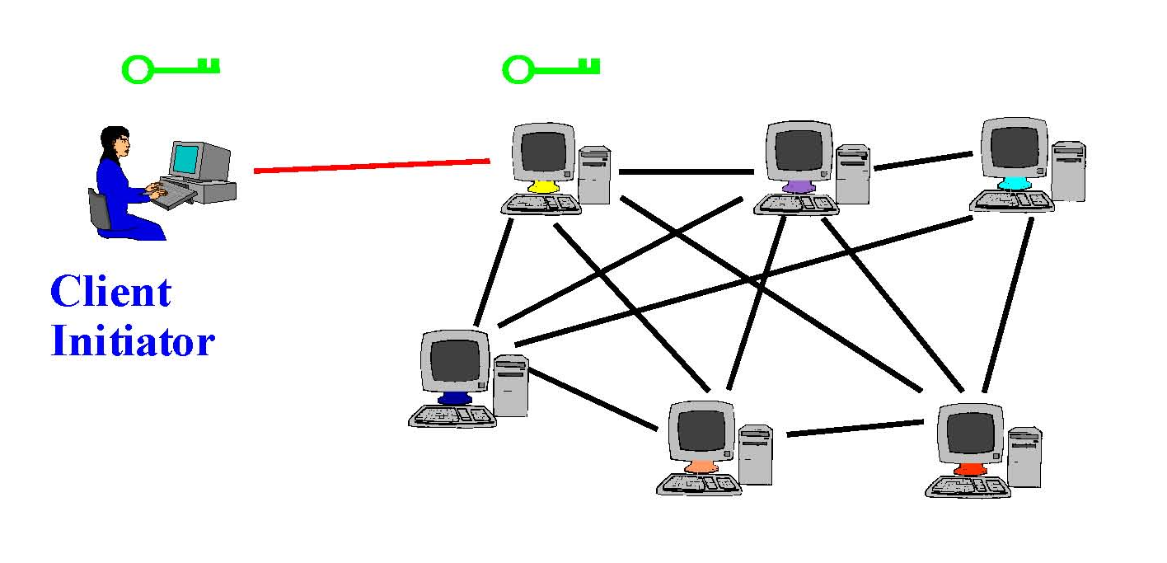
Tor Circuit Setup (1)
Client proxy establish a symmetric session key and circuit with relay node #1

Slide 13
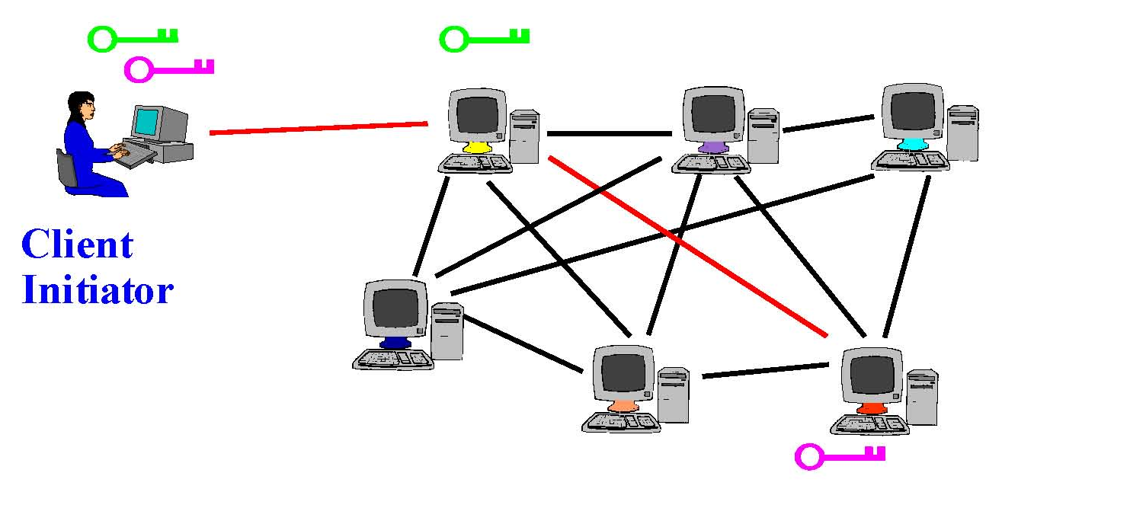
Tor Circuit Setup (2)
Client proxy extends the circuit by establishing a symmetric session key with relay node #2
Tunnel through relay node #1

Slide 14

Tor Circuit Setup (3)
Client proxy extends the circuit by establishing a symmetric session key with relay node #3
Tunnel through relay nodes #1 and #2

Slide 15
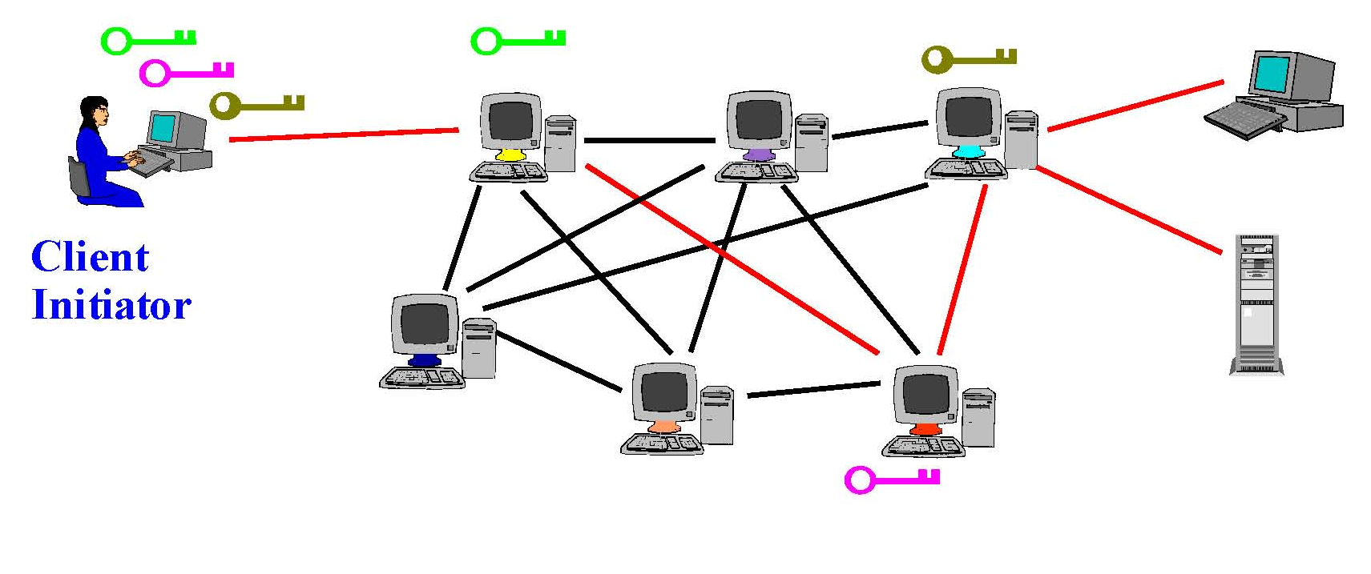
Using a Tor Circuit
Client applications connect and communicate over the established Tor circuit
Datagrams decrypted and re-encrypted at each link

Slide 16
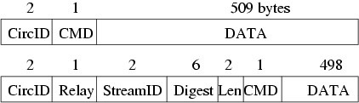
Cells
All data is sent in fixed size (512 bytes) cells
Control cell commands:
Padding, create, destroy
Relay cell commands:
Begin, data, connected, extended, teardown, ...
many circuits can be multiplexed over the single TLS connection hence the circuit IDs

Slide 17
Tor circuit communication
E(x) = Public-key crypto
H() =hash function
K_{i}=g^{xi. yi}=AES key
Symmetric key used for the actual data transfer
Diffie-Hellman
https://en.wikipedia.org/wiki/Diffie%E2%80%93Hellman_key_exchange

Slide 18
Building a circuit (message type)
Create c₂ E(g^{x2})
Created c₁, g^{y1}, H(K₁)
Created c₂, g^{y2}, H(K₂)
Relay c₁(Extended, g^{y2}, H(K₂)
Create c₁, E(g^{x1})
Relay c₁ (Extend, OR₂, E(g^{x1}))

Slide 19
Fetching a web page
Relay c₂ (Begin <Bob>)
Relay c₂ (Connected)
Relay c₁ (Connected)
TCP Handshake
Relay c₁ (Begin <Bob>)
Last onion router should get the IP address of Bob’s website to protect Alice’s anonymity.

Slide 20
Additional functionality
Integrity checking
Only done at the edges of a stream
SHA-1 digest of data sent and received [easy to match to detect change in content]
First 4 bytes of digest are sent with each message for verification
Rate limiting
Uses token bucket approach across all the tunnels
Interactive streams get preferential treatment

Slide 21
Congestion Control
Circuit Level throttling
2 windows keep track of relay data to be transmitted to other ORs and data transmitted out of the network (window size 1000 cells)
Windows are decremented after forwarding packets and increments on a relay sendme message
When a window reaches 0, no messages are forwarded
Stream Level Throttling
Streams have packaging windows associated with them (window size 500 cells)
The window is decremented when messages are sent and incremented when relay sendme are received
relay sendme messages are sent after the TCP stream has flushed a certain number of bytes

Slide 22
Using Tor
Many applications can share one circuit
Multiple TCP streams over one anonymous connection
Tor router doesn’t need root privileges
Encourages people to set up their own routers
More participants = better anonymity for everyone
Directory Authority (DA) servers
Maintain lists of active relay nodes, their locations, current public keys, etc.
Control how new nodes join the network
“Sybil attack”: attacker creates a large number of relays
Directory servers’ keys ship with Tor code
10 DA currently
Entries updated every one hour
7/10 DA perform bandwidth scanning

Slide 23
How Do You Use Tor?
Download, install, and execute the Tor client
The client acts as a SOCKS proxy
The client builds and maintains circuits of relays
Configure your browser to use the Tor client as a proxy
Any app that supports SOCKS proxies will work with Tor
Current Tor browsers installs the Tor client internally
All traffic from the browser will now be routed through the Tor overlay

Slide 24
Tor Relay type
Entrance (Guard) Node
The first node in a circuit
Knows the user
Exit Node
Final node in the circuit
Knows the destination
May see actual message
Middle Node
Doesn’t occupy the guard and exit position
Most nodes are middle only

Slide 25
Selecting Relays
How do clients locate the Tor relays?
Tor Consensus File
Hosted by trusted directory servers
Lists all known relays
IP address, uptime, measured bandwidth, etc.
Not all relays are created equal
Entry/guard and exit relays are specially labelled
Why?
Tor does not select relays randomly
Chance of selection is proportional to bandwidth
Why? Is this a good idea?

Slide 26
Guard Relays
Guard relays help prevent attackers from becoming the first relay
Tor selects 3 guard relays and uses them for 3 months
After 3 months, 3 new guards are selected
Only relays that:
Have long and consistent uptimes…
Have high bandwidth…
And are manually vetted may become guards (consensus servers)

Slide 27
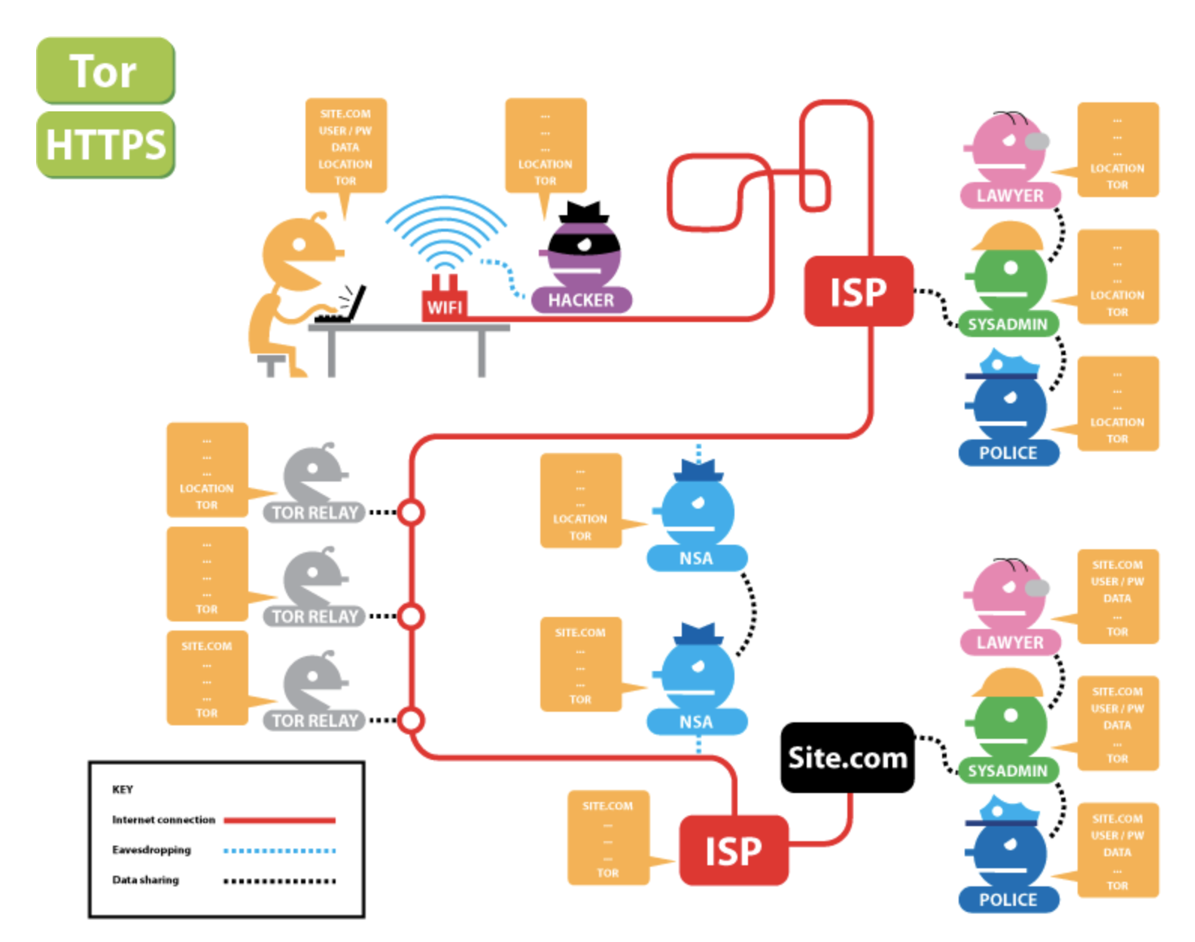
Data seen by different parties
Site
User/PW
Data
Location
Tor
Location
Tor
Tor
NSA
Site
Tor
Site
User/PW
Data
Tor
https://www.eff.org/pages/tor-and-https

Slide 28
Tor Bridges
Anyone can look up the IP addresses of Tor relays
Public information in the consensus file
Many countries block traffic to these IPs
Essentially a denial-of-service against Tor
Solution: Tor Bridges
Essentially, Tor proxies that are not publicly known
Used to connect clients in censored areas to the rest of the Tor network
Tor maintains bridges in many countries

Slide 29
Demo using Tor browser

Slide 30
Hidden Services
Tor is very good at hiding the source of traffic
But the destination is often an exposed website
What if we want to run an anonymous service?
i.e. a website, where nobody knows the IP address?
Tor supports Hidden Services
Allows you to run a server and have people connect
… without disclosing the IP or DNS name
Many hidden services
Tor Mail, Tor Char
DuckDuckGo
Wikileaks
The Pirate Bay
Silk Road (2.0)

Slide 31





Hidden Service Example
DB of hidden service
Introduction Points
https://go2ndkjdf8whfanf4o.onion
Hidden
Service
Rendezvous Point
Demo
Onion URL is a hash, allows any Tor user to find the introduction points

Slide 32
Creating and connecting to a Location hidden service

Slide 33
Perfect Forward Secrecy
In traditional mix networks, all traffic is encrypted using public/private keypairs
Problem: what happens if a encryption key is stolen?
All future traffic can be observed and decrypted
If past traffic has been logged, it can also be decrypted
Tor implements Perfect Forward Secrecy (PFC)
The client negotiates a new shared key with each relay during circuit creations
Original public-private keypairs are only used for key setup
i.e. to verify the authenticity of messages

Slide 34
Obfuscating Tor Traffic
Bridges alone may be insufficient to get around all types of censorship
DPI can be used to locate and drop Tor frames
Iran blocked all encrypted packets for some time
Tor adopts a pluggable transport design
Tor traffic is forwarded to an obfuscation program
Obfuscator transforms the Tor traffic to look like some other protocol
BitTorrent, HTTP, streaming audio, etc.
Deobfuscator on the receiver side extracts the Tor data from the encoding

Slide 35
Threats in Tor
Does not protect against a global passive adversary
Adversary can:
Operate onion routers
Compromise many onion routers
Generate, modify, delay and delete traffic

Slide 36
Attacks possible
Passive Attacks
Observing user content
End-to-end timing correlation
Active Attacks
Compromising Keys
Run a hostile OR
Attacks on the Directory Service
Destroy directory service
Subvert 1 or more directory servers
Attacks against rendezvous points
Make many introduction requests
Compromise a rendezvous point

Slide 37


Passive Attacks Against Tor Circuits
Source: known
Dest: known
Source: known
Dest: unknown
Source: unknown
Dest: unknown
Source: unknown
Dest: known
Entry/
Guard
Middle
Exit
Tor users can choose any number of relays
Default configuration is 3
Why would higher or lower number be better or worse?

Slide 38
Predecessor Attack
This is the predecessor attack
Attacker controls the first and last relay
Probability of being in the right positions increases over time
Assumptions:
N total relays
M of which are controlled by an attacker
Attacker goal: control the first and last relay
M/N chance for first relay
(M-1)/(N-1) chance for the last relay
Roughly (M/N)² chance overall, for a single circuit
However, client periodically builds new circuits
Over time, the chances for the attacker to be in the correct positions improves!

Slide 39





End-to-end Timing Attack in Tor
Tor relays are run by volunteers. So relays can be malicious.
Timing Correlation
Assuming c fraction of the total bandwidth is controlled by an adversary
Probability of circuits being compromised: Pr(compromised circuit) = c²
If guards are compromised then prob. increases, but obtaining guard status is not easy

Slide 40
Active Attack: Selective DoS
Drop circuits that can’t be compromised
New Circuit
Dropped
Not Dropped
C- Compromised
H- Honest Relay
Guard | Middle | Exit
H | H | C
H | C | C
H | C | H
C | H | H
C | C | H
Guard | Middle | Exit
C | H | C
C | C | C
H | H | H
Dropped

Slide 41
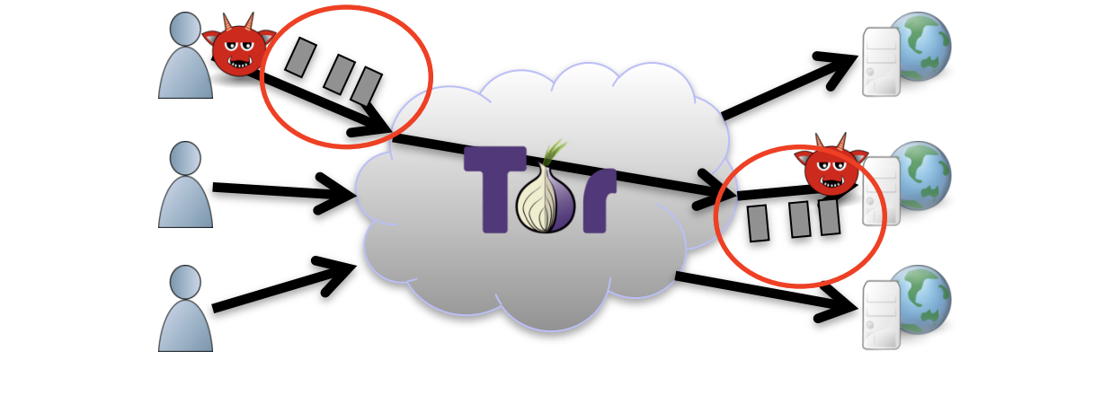
Traffic Confirmation Techniques
Congestion and denial-of-service attacks
Attack a Tor relay, see if circuit slows down
Throughput attacks
Latency leaks
Website fingerprinting

Slide 42
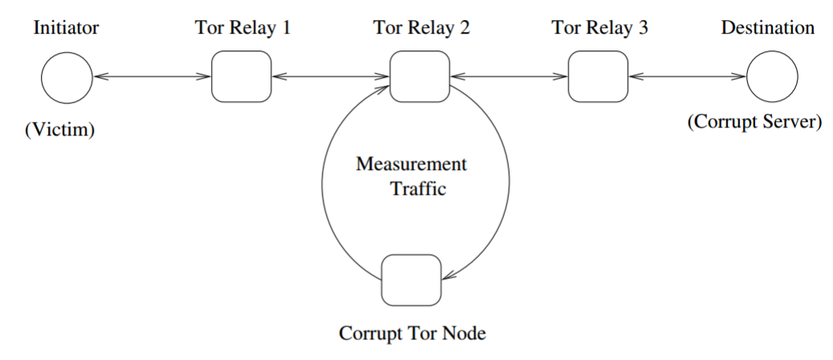
Indirect load estimation
Adversaries only need an estimate of traffic load.
Possible indirect clogging attacks: inject pattern at corrupt server, and trace through indirect load estimation.
Steven J. Murdoch, George Danezis: Low-Cost Traffic Analysis of Tor. IEEE Symposium on Security and Privacy 2005: 183-195

Slide 43
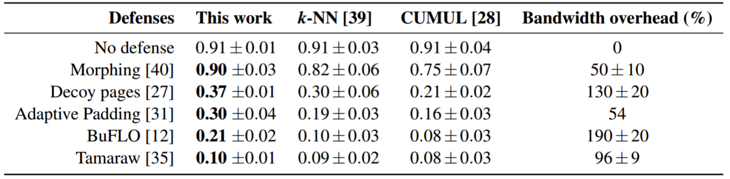
Tor problems: website fingerprinting
Tor does not significantly disrupt the timing, volume and dynamics of web browsing streams.
Website fingerprinting uses machine learning to guess which web page is being loaded through tor.
It works well, even against delaying, cover and other defences.
Jamie Hayes, George Danezis: k-fingerprinting: A Robust Scalable Website Fingerprinting Technique. USENIX Security Symposium 2016: 1187-1203

Slide 44
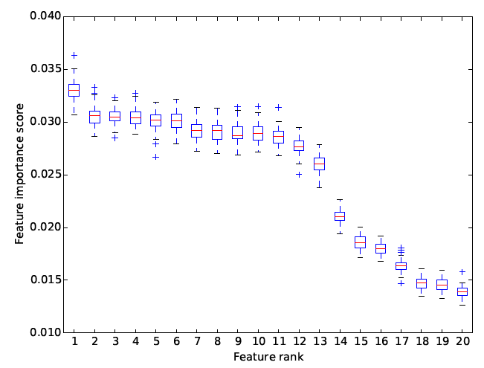
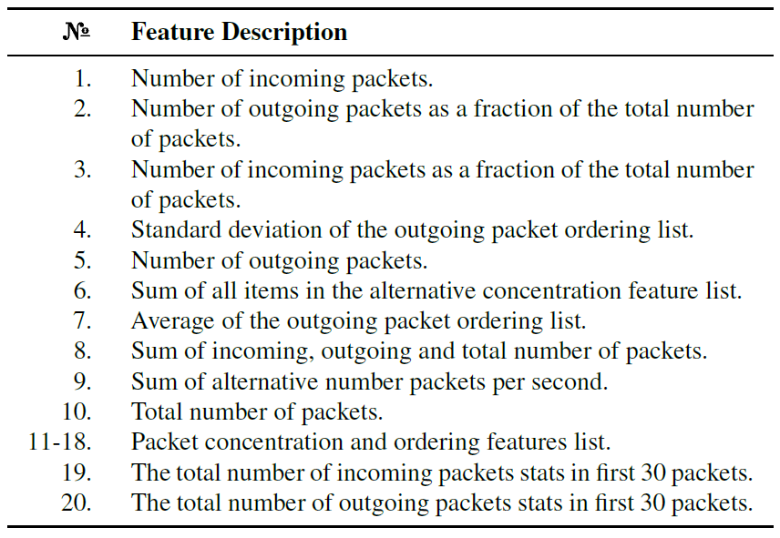
What features allow fingerprinting?
Random forest classifier allows for feature importance analysis.

Slide 45
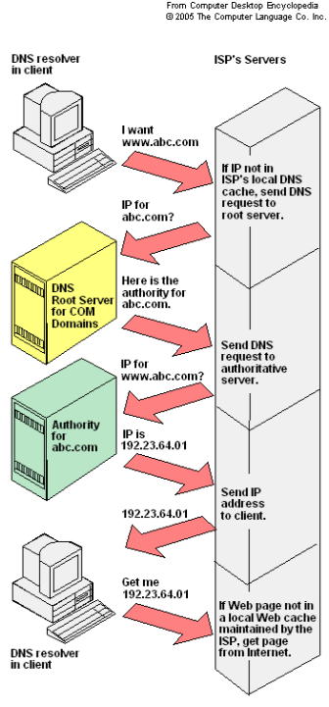
DNS Leaks
DNS requests not sent through Tor network by default
Attacker could see what websites are being visited
external software such as Foxyproxy and Privoxy can be used to route DNS requests through tor network, but this is _not_ default behavior

Slide 46
And many more problems …
Traffic analysis:
Sampling attacks
IX, AS sampling & BGP rerouting attacks
In conclusion: Tor is great if you want to hide from a relatively weak adversary. Not so great against more powerful adversaries…

Slide 47
Conclusion
Introduced Tor
Lots more work in anonymous communications
Dozens of other proposed systems
Tarzan, Bluemoon, etc.
Many offer much stronger anonymity than Tor
… however, performance is often a problem

Slide 48


Anonymous P2P Networks
Goal: enable censorship resistant, anonymous communication and file storage
Content is generated anonymously
Content is stored anonymously
Content is highly distributed and replicated, making it difficult to destroy
Examples
FreeNet
GNUnet

Slide 49
Logistics
Mid-term exam
Date Oct. 01, 2020
Through Moodle (be available for fixed time)
During class time (1 hr 15min)
DE students if possible try to do it during class time. If not possible contact me.

